Slide 1
P, NP, and NP-Complete
Instructor: Yao-Ting Huang
Bioinformatics Laboratory,
Department of Computer Science & Information Engineering,
National Chung Cheng University.

Slide 2
Shortest Path Problems
Bellman-Ford algorithm runs in O(VE) time.
Dijkstra’s algorithm runs in O(E log V) time.

Slide 3
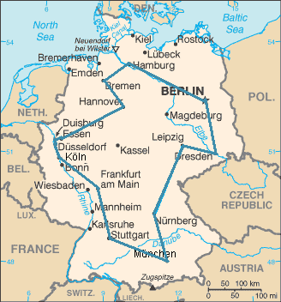
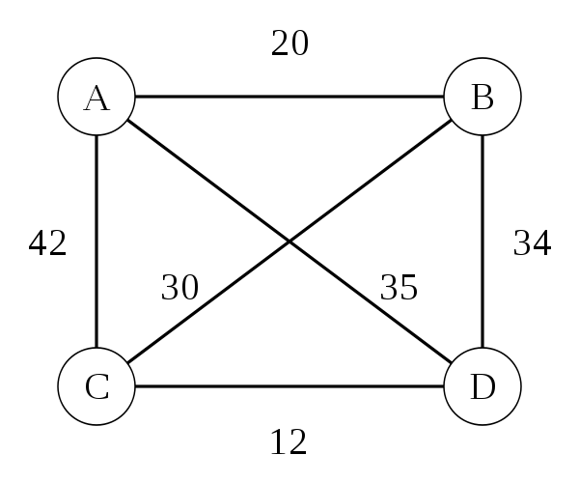
Traveling Salesman Problem (TSP)
A complete graph with cost c(i, j) to go from city i to city j.
A salesman must travel to n cities, visiting each city exactly once and finishing where he begins with minimized travel cost.

Slide 4
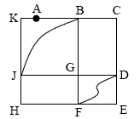
Euler Tour and Euler Path
Euler tour: a cycle that traverses each edge of graph G exactly once (vertices can be revisited.).
4
2
5
8
1
3
6
9
7

Slide 5
Hamiltonian-cycle problem
The hamiltonian-cycle problem:
A hamiltonian cycle of an undirected graph is a simple cycle that visits every vertex once.
Given a graph G, does it have a hamiltonian cycle?

Slide 6
Satisfiability (SAT) Problem
The SAT problem is to determine whether a boolean expression is satisfiable.
2^{n} different truth assignments.

Slide 7
2SAT v.s. 3SAT
2SAT is a special case where each clause has exactly 2 literals.
3SAT is a special case where each clause has exactly 3 literals.
But the hardness of these two problems is dramatically different.

Slide 8
Hardness of a Problem
Over the years, computer scientists have identified a subset of problems difficult to be solved within polynomial time.
Can we know in advance whether a problem is solvable in polynomial time?

Slide 9
Decision Problems
Decision problems are problems in which the answer is simply Yes or No.
e.g., Euler Tour, Hamiltonian cycle.

Slide 10
Optimization Problems
Optimization problems asks for optimal solutions maximizing/minimizing an objective function.
e.g., shortest path problems: find the shortest path starting from s to all other vertices.
e.g., Travelling Salesman Problem.

Slide 11
Decision v.s. Optimization Problems
Every optimization problem has a simpler decision version.
Optimization version: Given a directed graph, and vertices u and v, find the shortest path starting from u to v.
Decision version: Given a directed graph, vertices u and v, and an integer k, is there a path starting from u to v with length at most k?

Slide 12
Decision v.s. Optimization Problems
The decision version of an optimization problem is relatively “easier.”
If we have an algorithm for solving the optimization problem, the decision version can be also solved.
e.g., Given a directed graph, vertices u and v, and an integer k, is there a path starting from u to v with length at most k?
Run a shortest path algorithm (e.g., Bellman-Ford), observe the shortest path from u to v, and return Yes or No.

Slide 13
Remarks
If the decision version of a problem is hard, the optimization version is not easier.
The hardness proof can be simplified when focusing on proving decision version of any optimization problems.
Optimization Version
Decision Version

Slide 14
Complexity
The big O notation.
Constant is not important.
Highest-order term is what counts.
The worst-case running time.
Polynomial time: O(n²), O(n³), O(1), O(n log n).
Exponential time: O(2^{n}), O(n^{n}), O(n!).

Slide 15
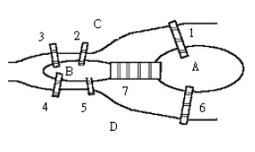
Polynomial-Time Algorithms
We define P to be the class of decision problems solvable in polynomial time by a deterministic Turing machine.
Euler tour: a cycle that traverses each edge of graph G exactly once (vertices can be revisited.).

Slide 16
P
Problems in P:
Longest common subsequence
Shortest path.
Minimum spanning tree.
Euler tour.
Network flow.
…

Slide 17
Problems Not in P
Hamiltonian cycle is not in P (for now).
TSP problem is not in P.
SAT problem is not in P.
…
Can we classify problems outside P?

Slide 18
NP
NP (nondeterministic polynomial time) is the set of decision problems that can be solved by a nondeterministic Turing machine in polynomial time.
P to be the class of decision problems solvable by a deterministic Turing machine in polynomial time

Slide 19
Nondeterminism
Informally, a non-deterministic Turing machine (NTM) is a parallel computer with an infinite number of processers and unlimited bandwidth.
Have one processor work on verifying each possible solution
Each processors verifies its own solution in parallel.
If an “Yes” solution exists, that NTM can find it.

Slide 20
Nondeterminism
Informally, a non-deterministic Turing machine (NTM) is a parallel computer with an infinite number of processers and unlimited bandwidth.
Have one processor work on verifying each possible solution
Each processors verifies its own solution in parallel.
If an “Yes” solution exists, that NTM can find it.
NP = problems whereas solutions can be verifiable in polynomial time
More precisely, NP is the set of problems in which an “Yes” answer can be verified in polynomial time.

Slide 21
Satisfiability (SAT) Problem
The SAT problem is to determine whether a boolean expression is satisfiable.
Is SAT problem in NP?
Someone claimed he got a solution satisfying the following boolean expression.
It is easy to verify if his solution indeed satisfies.

Slide 22
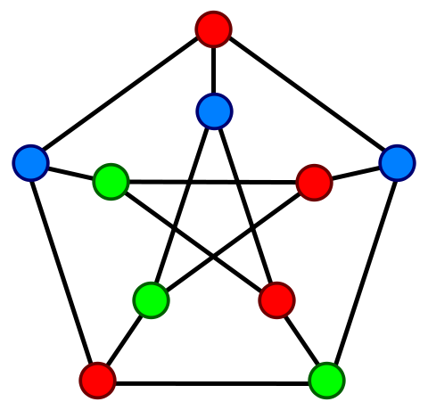
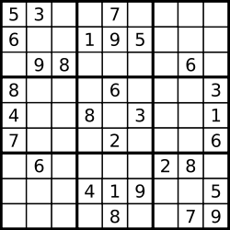
Graph Coloring Problem
The k-coloring problem aims to color the vertices of a graph using k colors such that no two adjacent vertices have the same color.
Is k-color in NP?

Slide 23
Examples
Is Hamiltonian cycle problem in NP?

Slide 24
Example
Is Euler Tour problem in NP?

Slide 25
P and NP
Summary so far:
P = problems that can be solved in polynomial time
NP = problems for which an Yes solution can be verified in polynomial time.
All problems in P satisfy the property of NP.
NP does not necessarily refer to hard problems.
NP
P

Slide 26

P = NP??
We call this the P = NP question
The biggest open problem in CS.
If you can prove or disprove this equation, you will be awarded Turing Award for sure plus at least US 1,000,000.
Retire and enjoy your life.

Slide 27
P = NP??
But unfortunately, we failed to obtain polynomial time algorithm for many problems.
Hamiltonian cycle
TSP
Clique
Vertex cover
…
It looked some problems in NP are relatively “harder” than others.
We shall return to this topic later.

Slide 28
P and NP
P = problems that can be solved in polynomial time
NP = problems for which an Yes solution can be verified in polynomial time.
NP does not necessary refer to hard problems.
NP
P
NP-complete

Slide 29
Polynomial-Time Reduction
A polynomial-time reduction algorithm provides an indirect way to solve a problem
1. Given an instance α of problem A, use a polynomial-time reduction algorithm to transform it to an instance β of problem B.
2. Run the polynomial-time decision algorithm for B on the instance β.
3. Transform the answer of β into the answer for α.
yes
yes
α
Polynomial-time
reduction algorithm
β
Polynomial-time
Algorithm to decide B
no
no
Polynomial-time algorithm to decide A

Slide 30
An Example of Reduction
P: Single source shortest-path
Given a source vertex, find shortest-paths from s to all other vertices.
Q: All pairs shortest paths
P can be solved by solving Q.
Q is at least as hard as P.

Slide 31

LIS to LCS
Find the longest chain of pairs in the same orientation.
e.g., {a e f g h} and {a b c d g h} are feasible solutions.
{a d e f g h} is not a feasible solution.
1
2
3
4
5
6
7
8
1
5
6
2
3
4
7
8
LIS = 1, 2, 3, 4, 7, 8

Slide 32
Reduction
Reduction transforms input of one problem P to problem Q, solving P indirectly through solving Q.
If P reduces to Q, P is “no harder to solve” than Q(Q至少比P難)
Q is at least as hard as P.
B 還包含了其他集，例如C、D，導致B比較複雜
A LIS
B LCS

Slide 33
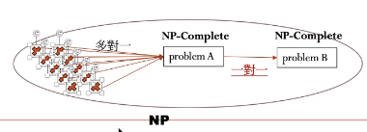
NP-Hard and NP-Complete
Definition of NP-Hard:
If all problems in NP are reducible to a problem B, then A is mapped to problem B. So B is called NP-Hard.
但已有人證出Ploblem A，我們即需要想出Problem B來對應我們要解的問題
Definition of NP-Complete:
B is NP-Complete if B is NP-Hard and B ∈ NP.
超困難

Slide 34
NP-Complete Problems
You can feel that NP-Complete problems are the “hardest” problems in NP:
If any NP-Complete problem can be solved in polynomial time, every problem in NP can be solved in polynomial time.
That is, you have proven P = NP
Thus: solve Hamiltonian-cycle in O(n¹⁰⁰⁰⁰⁰) time, you’ve proved that P = NP. Retire rich & famous.

Slide 35
NP-Hard and NP-Complete
Definition of NP-Hard:
If all problems in NP are reducible to P, then P is called NP-Hard
Definition of NP-Complete:
B is NP-Complete if B is NP-Hard and B ∈ NP
If B ≤_{p} Q and B is NP-Hard (or NP-Complete), Q is also NP-Hard.
This is the key idea you should take away today

Slide 36
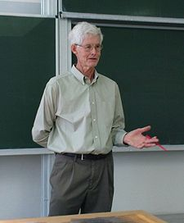
Stephen Cook
Stephen Arthur Cook (born 1939) proved the first NP-complete problem.
Cook received the Turing Award in 1982.
Cook formalized the notion of NP-completeness in 1971 and proved the first NP-complete problem called circuit satisfiability problem.
The math department of UC Berkeley infamously denied him tenure.
Cook then joined the faculty at the University of Toronto.

Slide 37
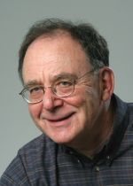
Richard Karp
Richard Karp (born 1935) is a computer scientist and a professor in UC Berkley.
In 1972, he published a landmark paper in complexity theory, "Reducibility Among Combinatorial Problems", in which he proved 21 Problems to be NP-complete.
In a speech celebrating the 30th anniversary of the Berkeley EECS department, Richard Karp said that, “It is to our everlasting shame that we were unable to persuade the math department to give him tenure.”

Slide 38
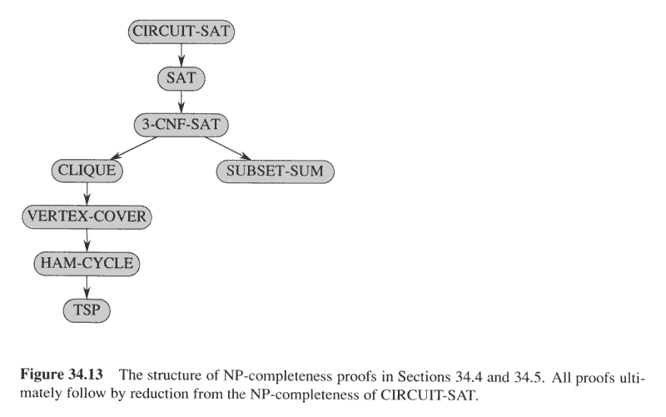
all problem -> problem A
problem A -> problem B
All problem (含B) -> problem A
因此若problem A可以reduced到problem B
則problem B也可以reduced到problem A
此圖則會變成complete graph的概念，可以互推

Slide 39
NP-Complete Problems
The NP-Complete problems are an interesting class of problems whose status is unknown
No polynomial-time algorithm has been discovered for an NP-Complete problem.
This class of problems are used to prove the hardness of a problem.
Though nobody has proven that P != NP, if you prove a problem is NP-Complete, most people agree that it is probably intractable.
Don’t try hard to come up with an efficient algorithm.

Slide 40
Proving NP-Completeness
What steps do we have to take to prove a problem P is NP-Complete?
Pick a known NP-Complete problem Q
Reduce Q to P
Describe a transformation that maps instances of Q to instances of P.
Prove that “Yes” for Q iff “yes” for P
Prove it runs in polynomial time

Slide 42
Traveling Salesman Problem
Traveling Salesman Problem (TSP): a complete graph with cost c(i, j) to go from city i to city j.
Optimization version: a salesman must travel to n cities, visiting each city exactly once and finishing where he begins with minimized cost.
Decision version: ask if there exists a tour with cost < k.

Slide 43
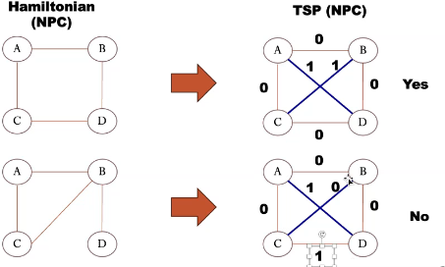
Traveling Salesman Problem
TSP={<G, c, k> | G = (V, E) is a complete graph, find a tour with cost < k=1}.
Reduction 要正確
需If and only if
Not Hamiltonian

Slide 44
Hamiltonian-cycle Problem
Suppose we know Hamiltonian-cycle problem is NP-complete.

Slide 45
Hamiltonian Cycle ⇒ TSP
The steps to prove TSP is NP-Complete:
Show TSP ∈ NP
Yes. It is easy to verify if one TSP tour is a feasible solution.

Slide 46
Hamiltonian Cycle ⇒ TSP
The steps to prove TSP is NP-Complete:
Show TSP ∈ NP
Reduce the undirected Hamiltonian cycle problem to the TSP problem.
If we had a TSP-solver, we could use it to solve the Hamilitonian cycle problem.
How can we reduce all instances of the Hamiltonian cycle problem to instances of the TSP?
Can we do this in polynomial time?

Slide 47
Hamiltonian Cycle ⇒ TSP
To reduce hamiltonian cycle problem G = (V,E) to TSP, create complete graph G’ = (V,E’):
G’ is a complete graph
Edges in E’ also in E have weight 0
All other edges in E’ have weight 1
TSP: is there a TSP on G’ with weight 0 (K<1)?
If G has a Hamiltonian cycle, G’ has a cycle with weight 0
If G’ has cycle with weight 0, every edge of that cycle has weight 0 and is thus in G. Thus G has a ham. cycle

Slide 48
Hamiltonian Cycle ⇒ TSP
We can construct G’ in polynomial time.
Edges in E’ also in E have weight 0
All other edges in E’ have weight 1
G
G’

Slide 49
Correctness of Reduction
If G has a hamiltonian cycle, G’ has a tour with weight 0.
If G’ has a tour with weight 0, every edge of that cycle has weight 0 and is thus in G. Thus G has a ham. cycle
G
G’
0
0
0
1
1
0
0
0
1
1

Slide 50
Summary
We proved that TSP is in NP.
We have reduced Hamiltonian cycle problem to the TSP problem.
If you can solve TSP problem, you can also solve the Hamiltonian cycle problem.
TSP is NP-complete.

Slide 51
Directed/Undirected Ham. Cycle
Suppose we have known Hamitonian-cycle problem in directed graph is NP-complete.
Does Hamitonian-cycle problem in undirected graph is easier?

Slide 52
Undirected Ham. cycle is in NP
Given a sequence of V vertices that makes up the hamiltonian cycle.
The verification algorithm checks if this sequence contains each vertex exactly once.
The first vertex is repeated at the end.
It checks if there is an edge between all pairs of vertices (cycle).

Slide 53
Directed ⇒ Undirected Ham. Cycle
Transform graph G = (V, E) into G’ = (V’, E’):
Every vertex v in V transforms into 3 vertices v¹, v², v³ in V’ with edges (v¹,v²) and (v²,v³) in E’
Every directed edge (v, w) in E transforms into the undirected edge (v³, w¹) in E’ (draw it)
Can this be implemented in polynomial time?
G’
G
G
v¹
v³
O
v²
X

Slide 54
Directed ⇒ Undirected Ham. Cycle
Transform graph G = (V, E) into G’ = (V’, E’):
Every vertex v in V transforms into 3 vertices v¹, v², v³ in V’ with edges (v¹,v²) and (v²,v³) in E’
Every directed edge (v, w) in E transforms into the undirected edge (v³, w¹) in E’.
Another example:
G’
G

Slide 55
Correctness of Reduction
Prove the reduction is correct:
If G has directed hamiltonian cycle, G’ will have undirected cycle (straightforward)
G
G’

Slide 56
Directed ⇒ Undirected Ham. Cycle
Is it possible G’ has a hamiltonian cycle but G does not have?
G
G’

Slide 57
Directed ⇒ Undirected Ham. Cycle
If G’ has an undirected hamiltonian cycle, G will have a directed hamiltonian cycle as well.
The three vertices that correspond to a vertex v in G must be traversed in order v¹ ⇒ v² ⇒ v³ or v³ ⇒ v² ⇒ v¹, since v² cannot be reached from any other vertex in G’
Without loss of generality, each edge (v³, w¹) of Hamiltonian cycle in E’ corresponds to the directed edge (v, w) in E.
Then G=(V,E) has a corresponding directed Hamiltonian cycle
v¹
v³
v²

Slide 58
Directed ⇒ Undirected Ham. Cycle
If G’ has an undirected hamiltonian cycle, G will have a directed hamiltonian cycle as well.
The edge direction is guaranteed by the order of traversal in undirected reduction.
1 → 2 → 3 → 1 → 2 → 3 → 1 → 2 → 3 …
Notes:
It’s impossible G’ has a cycle but G does not have.

Slide 59
Remarks
NP-complete (NPC) problems are problems requiring exponential time algorithm so far.
Pickup an existing NPC problem.
Construct and prove correctness of the reduction.
There are still problems belonging to NP but neither in P nor in NP-complete.
These problems are confusing, since if they are NP-complete, we will give up looking for polynomial time algorithm.
NP
NP Complete
P

Slide 60
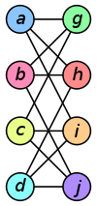
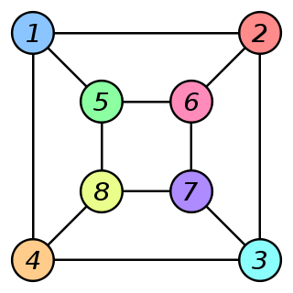
Graph Isomorphism(同構)
The graph isomorphism problem is neither in P nor NP-complete at this moment.

Slide 61
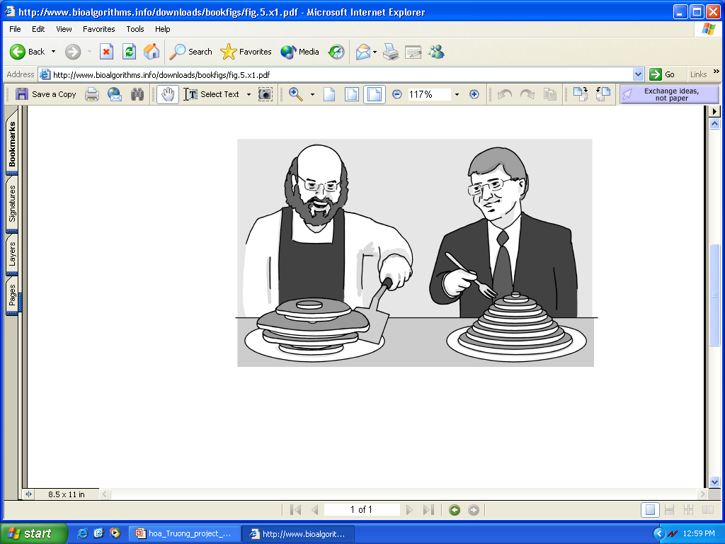
Pancake Flipping Problem
The chef is sloppy; he prepares an unordered stack of pancakes of different sizes
The waiter wants to rearrange them (so that the smallest winds up on top, and so on, down to the largest at the bottom)
He does it by flipping over several from the top, repeating this as many times as necessary
declared to be NP-hard by 2011.

Slide 62
Pancake Flipping Problem
Goal: Given a stack of n pancakes, ask for the minimum number of flips to rearrange them into perfect stack.
Is this problem in P??
Complexity is still unknown but good approximation algorithms exist.
A 2-Approximation Algorithm for Sorting by Prefix Reversals, ESA 2005.

Slide 63
Pancake Flipping Problem
Bill Gates and Christos Papadimitriou showed in 1979 that this problem can be solved by at most 5/3 * (n + 1) prefix reversals.
Christos Papadimitrou and Bill Gates flip pancakes

Slide 64
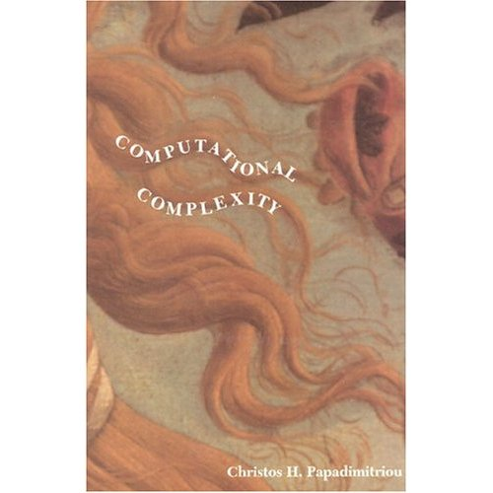
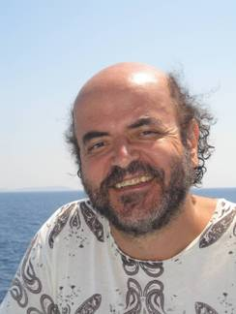
Christos Papadimitriou
A professor in Department of Computer Science at UC Berkley.
A great master of computational complexity theory.

Slide 65

Bill Gates
Bill Gates solved the pancake problem with Papadimitriou before dropping his study in Havard.
Gates, W. and Papadimitriou, C. "Bounds for Sorting by Prefix Reversal." Discrete Mathematics. 27, 47-57, 1979.
The only paper Bill Gates ever published in his life.

Slide 66
A Joke (by Chao)
據說有人就向Papadimitriou提到：「Bill Gates一定很後悔沒繼續跟你做研究，不然一定能在電腦學術界名流千史，不會一天到晚被嫌棄Windows寫那麼糟糕。」
Papadimitriou回答說：「唉呀！該後悔的是我！如果我早知道跟他一起去開公司，我早就發了！」
He later joined a professor-and-graduate-student band called Lady X and The Positive Eigenvalues.

Slide 67
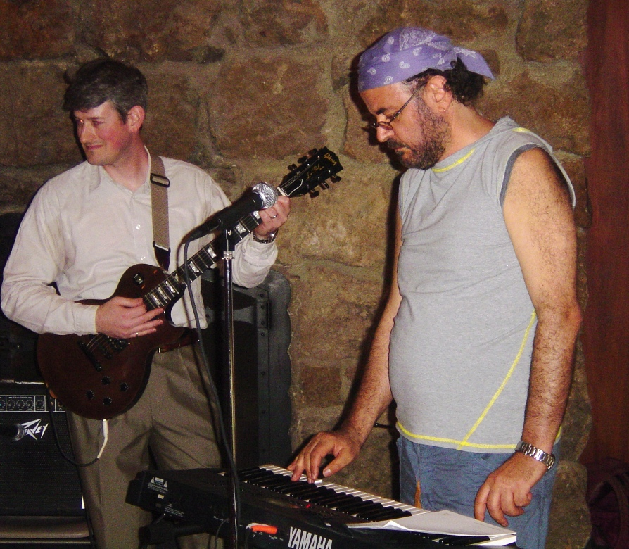
Christos Papadimitriou
Downloaded from http://circuit.ucsd.edu/~massimo/LadyX.html

Slide 68
Pancake Flipping Problem: Greedy Algorithm
Greedy approach: 2 prefix reversals at most to place a pancake in its right position.
2n – 3 steps total at most since the last two is easy.

Slide 69
Concluding Remarks
Hundreds of problems have been shown to be NP-Complete.
Hamiltonian path/cycle…
Vertex cover.
Set cover.
http://www.nada.kth.se/~viggo/problemlist/compendium.html
Some reductions are profound, some are comparatively easy, many are easy once the key insight is given.

